Slide 1


Chương 7 - Sequence Diagram

Slide 2
Content
Introduction
Interactions and interaction partners
Messages
Combined fragments
Branches and loops
Concurrency and order
Filters and assertions
Further language elements
Further types of interaction diagrams

Slide 3
Introduction
Modeling inter-object behavior (mô hình hóa hành vi giữa các objs)
= interactions between objects
Interaction (tương tác)
Specifies how messages and data are exchanged between interaction partners
Interaction partners (đối tượng tương tác)
Human (lecturer, administrator, …)
Non-human (server, printer, executable software, …)
Examples of interactions
Conversation between persons
Message exchange between humans and a software system
Communication protocols
Sequence of method calls in a program
…

Slide 4
Interaction Diagrams
Dùng để biểu diễn tương tác
Mô hình hóa các kịch bản chắc chắn
Mô tả chuỗi giao tiếp ở các mức độ chi tiết khác nhau
Interaction Diagrams show the following:
Giao tiếp giữa 1 hệ thống và môi trường
Giao tiếp giữa các thành phần của hệ thống để thể hiện cách một use case có thể hiện thực
Giao tiếp giữa các tiến trình trong đó các thành tố thực hiện một giao thức.
Giao tiếp giữa các cấp lớp (phép gọi hàm, hành vi tương giữa đối tượng)

Slide 5
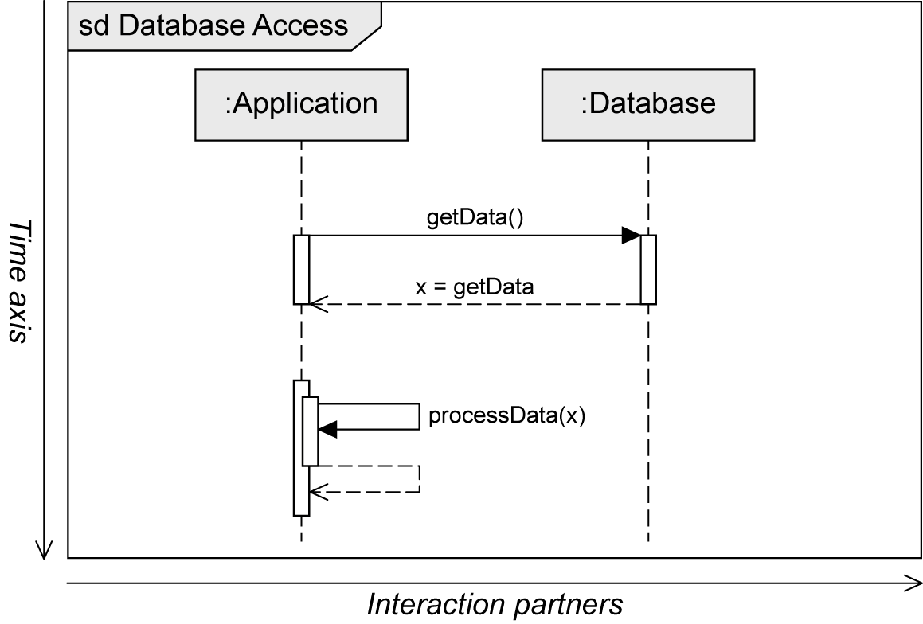
Sequence Diagram
Two-dimensional diagram
Horizontal axis: involved interaction partners
Vertical axis: chronological order (thứ tự thời gian) of the interaction
Interaction = sequence of event specifications

Slide 6
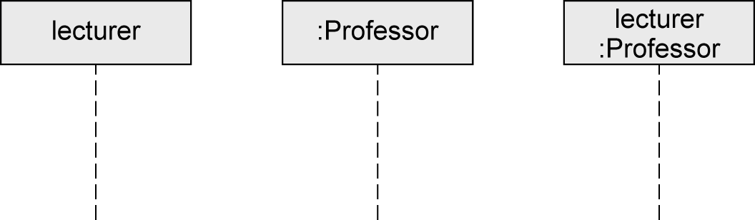
Interaction Partners
Interaction partners are depicted as lifelines
Head of the lifeline
Rectangle that contains the expression roleName:Class
Roles are a more general concept than objects
Object can take on different roles over its lifetime
Body of the lifeline
Vertical, usually dashed line
Represents the lifetime of the object associated with it
Head of the lifeline
Body of the Lifeline

Slide 7
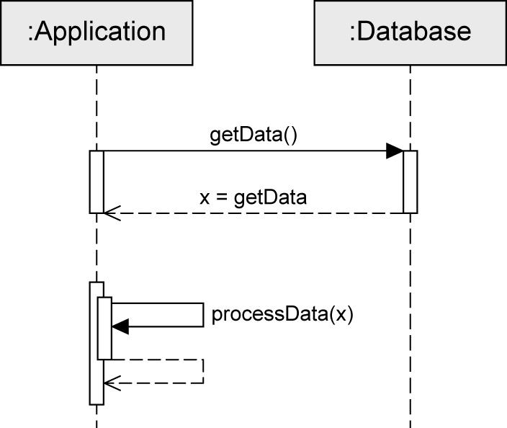
Exchanging Messages (1/2)
Interaction: sequence of events
Message is defined via send event and receive event
Execution specification
Continuous bar
Used to visualize when an interaction partner executes some behavior
Send event
Receive event
Execution specification

Slide 8
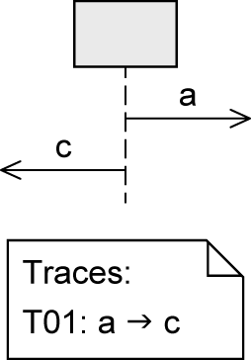
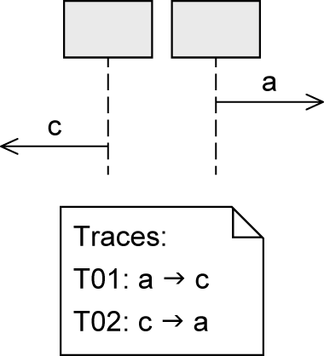
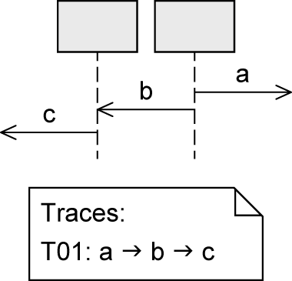
Exchanging Messages (2/2)
Order of messages:
… on one lifeline
… on different lifelines
»Happens before«
… on different lifelines which exchange messages

Slide 9
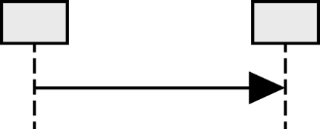
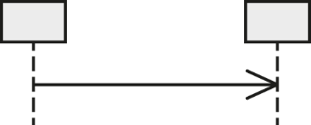

Messages (1/3)
Synchronous message (thông điệp đồng bộ)
Sender waits until it has received a response message before continuing
Syntax of message name: msg(par1,par2)
msg: the name of the message
par: parameters separated by commas
Asynchronous message (thông điệp bất đồng bộ)
Sender continues without waiting for a response message
Syntax of message name: msg(par1,par2)
Response message (thông điệp phản hồi)
May be omitted if content and location are obvious
Syntax: att=msg(par1,par2):val
att: the return value can optionally be assigned to a variable
msg: the name of the message
par: parameters separated by commas
val: return value

Slide 10
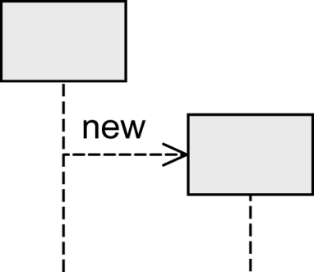
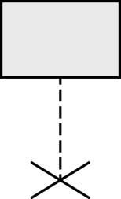
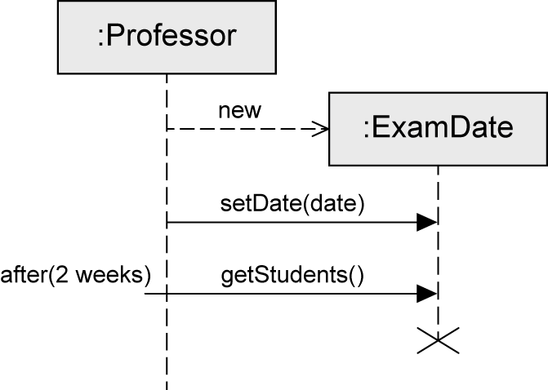
Messages (2/3)
Object creation (tạo obj)
Dashed arrow
Arrowhead points to the head of the lifeline of the object to be created
Keyword new
Object destruction (hủy obj)
Object is deleted
Large cross (×) at the end of the lifeline

Slide 11
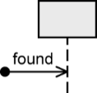
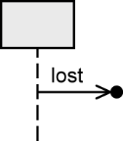
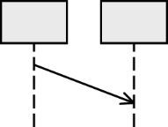
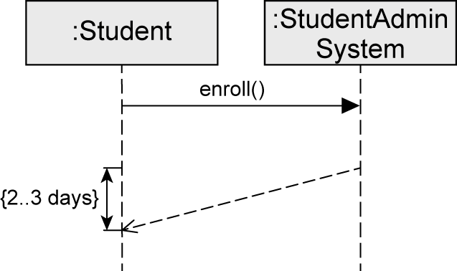
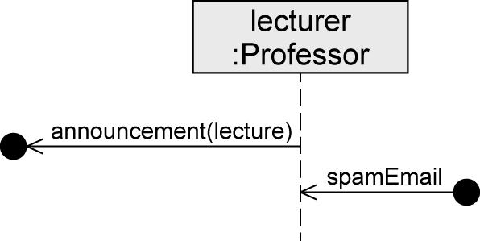
Messages (3/3)
Found message (thông điệp từ vô danh)
Sender of a message is unknown or not relevant
Lost message (thông điệp bị mất)
Receiver of a message is unknown or not relevant
Time-consuming message (thông điệp tốn thời gian)
"Message with duration"
Usually messages are assumed to be transmitted without any loss of time
Express that time elapses between the sending and the receipt of a message

Slide 12
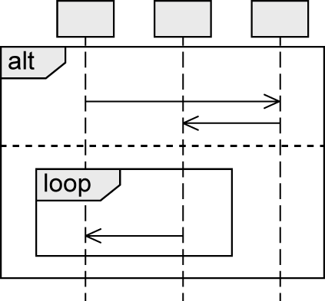
Combined Fragments
Model various control structures
12 predefined types of operators
Combined Fragment
Operator
Operand
Operand
Operand

Slide 13
Types of Combined Fragments
 | Operator | Purpose
 | alt | Alternative interaction (tương tác có thể lựa chọn)
 | opt | Optional interaction (tương tác tùy chọn)
 | loop | Repeated interaction (tương tác lặp)
 | break | Exception interaction (tương tác ngoại lệ)
 | seq | Weak order (lệnh yếu)
 | strict | Strict order (lệnh mạnh)
 | par | Concurrent interaction (tương tác song song)
 | critical | Atomic interaction (tương tác đơn nguyên)
 | ignore | Irrelevant interaction (tương tác không phù hợp)
 | consider | Relevant interaction (tương tác phù hợp)
 | assert | Asserted interaction (tương tác chèn)
 | neg | Invalid interaction (tương tác không hợp lệ)
Branches and loops
Concurrency and order
Filters and assertions

Slide 14
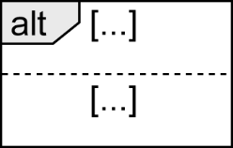
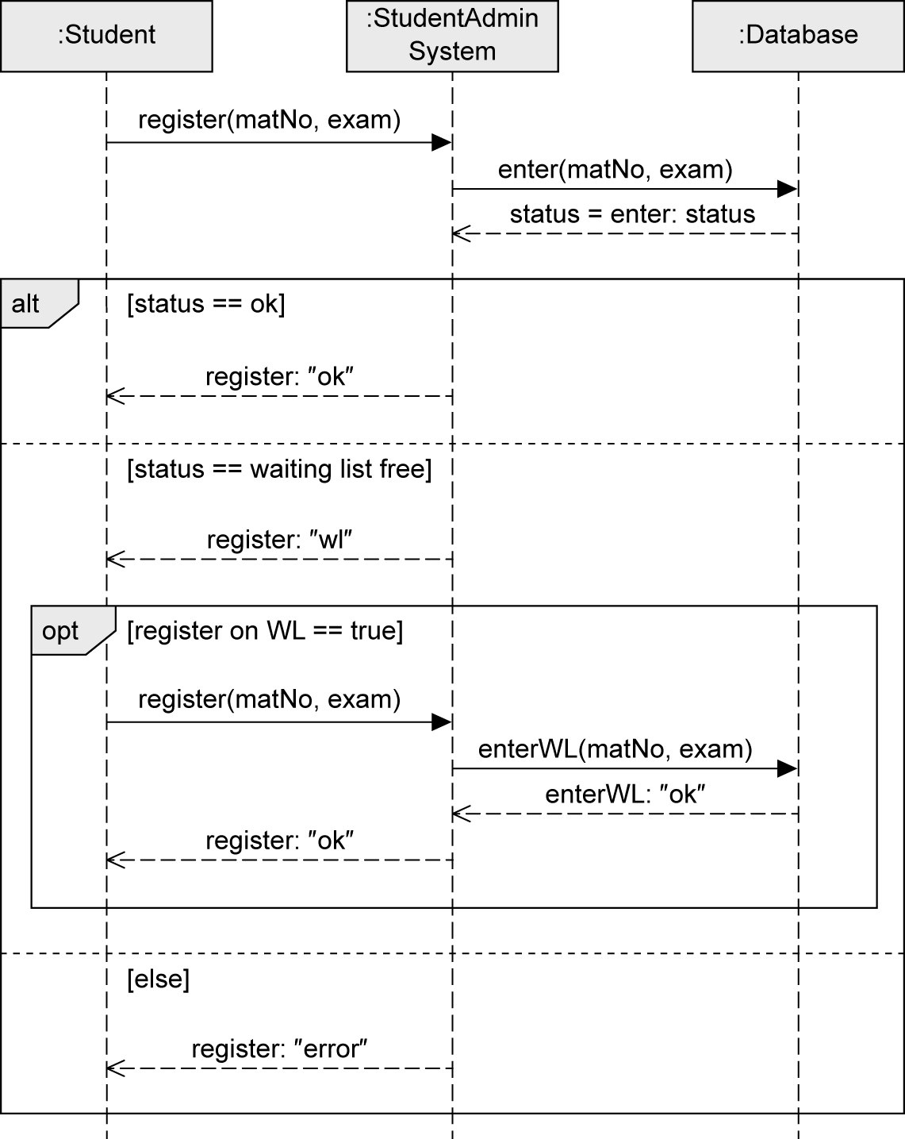
alt Fragment
To model alternative sequences
Similar to switch statement in Java
Guards are used to select the one path to be executed
Guards
Modeled in square brackets
default: true
predefined: [else]
Multiple operands
Guards have to be disjoint to avoid indeterministic behavior (hành vi không xác định)

Slide 15
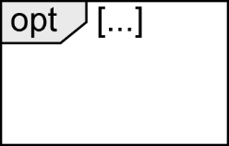
opt Fragment
To model an optional sequence
Actual execution at runtime is dependent on the guard
Exactly one operand
Similar to if statement without else branch
equivalent to alt fragment with two operands, one of which is empty

Slide 16
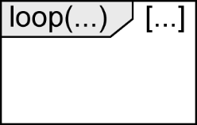
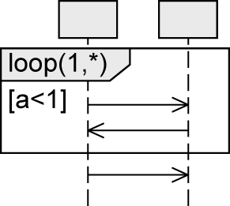
loop Fragment
To express that a sequence is to be executed repeatedly
Exactly one operand
Keyword loop followed by the minimal/maximal number of iterations (min..max) or (min,max)
default: (*) .. no upper limit
Guard
Evaluated as soon as the minimum number of iterations has taken place
Checked for each iteration within the (min,max) limits
If the guard evaluates to false, the execution of the loop is terminated
Max
Min
Guard
Notation alternatives:
loop(3,8) = loop(3..8)
loop(8,8) = loop (8)
loop = loop (*) = loop(0,*)
loop is executed at least once, then as long as a<1 is true

Slide 17
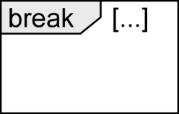
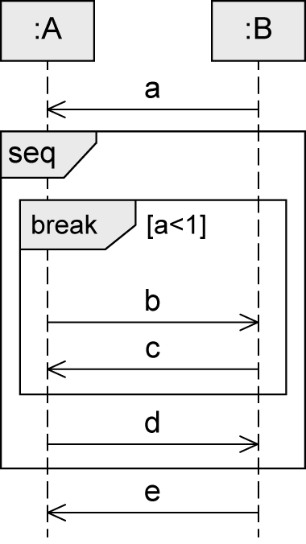
break Fragment
Simple form of exception handling
Exactly one operand with a guard
If the guard is true:
Interactions within this operand are executed
Remaining operations of the surrounding fragment are omitted
Interaction continues in the next higher level fragment
Different behavior than opt fragment
Not executed if break is executed

Slide 18
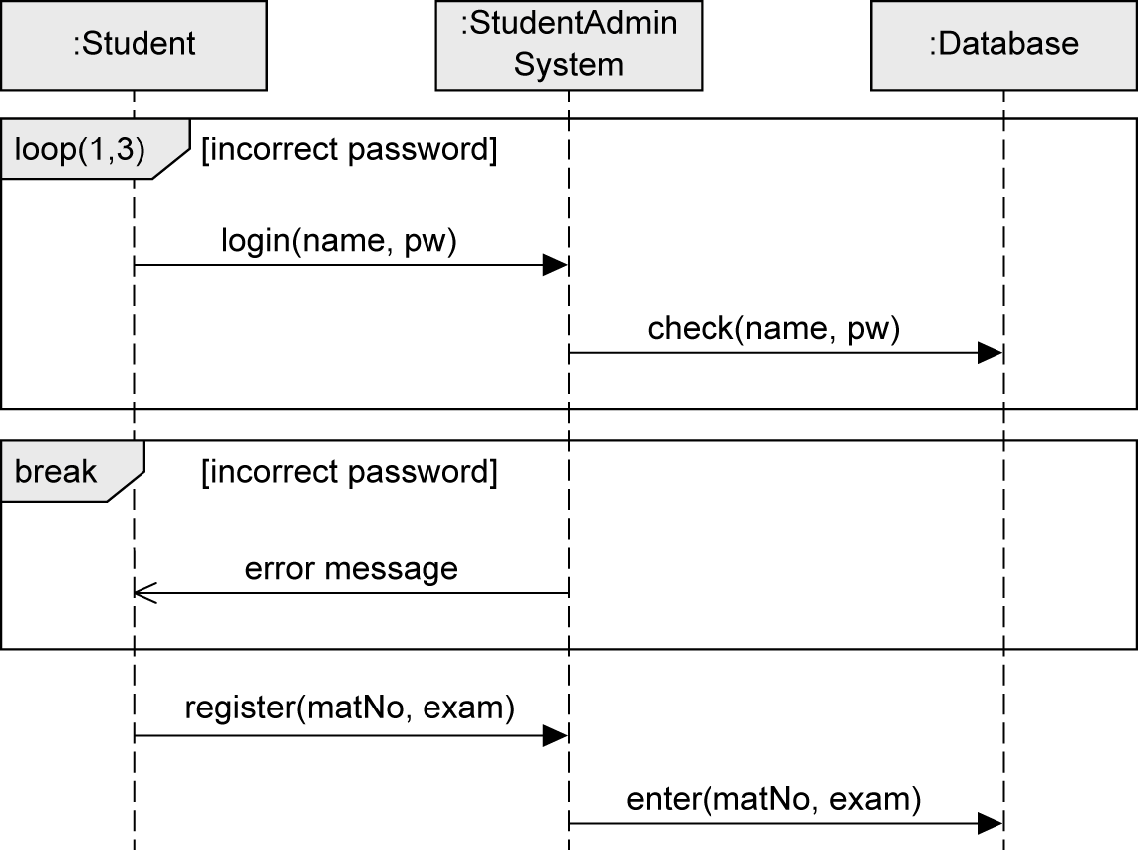
loop and break Fragment - Example

Slide 19
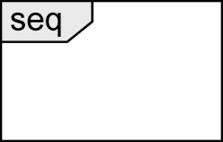
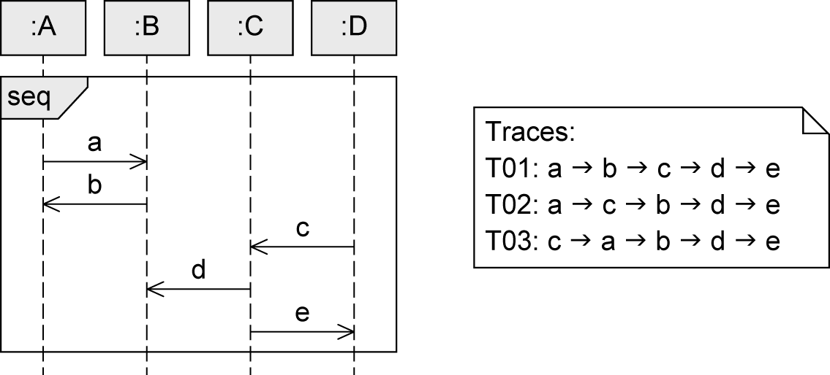
seq Fragment
Default order of events
Weak sequencing:
The ordering of events within each of the operands is maintained in the result. (Thứ tự của các sự kiện trong mỗi toán hạng được duy trì trong kết quả.)
Events on different lifelines from different operands may come in any order.(Các sự kiện trên các vòng đời khác nhau từ các toán hạng khác nhau có thể đến theo bất kỳ thứ tự nào.)
Events on the same lifeline from different operands are ordered such that an event of the first operand comes before that of the second operand.

Slide 20
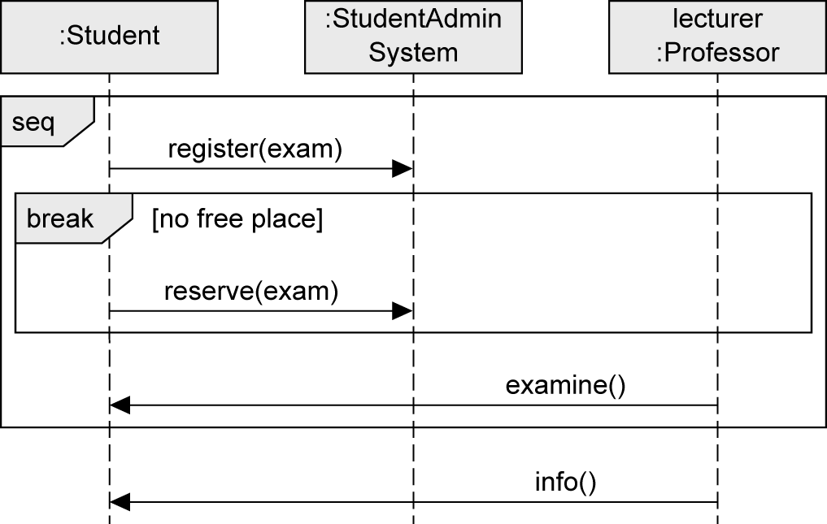
seq Fragment – Example

Slide 21
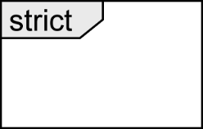
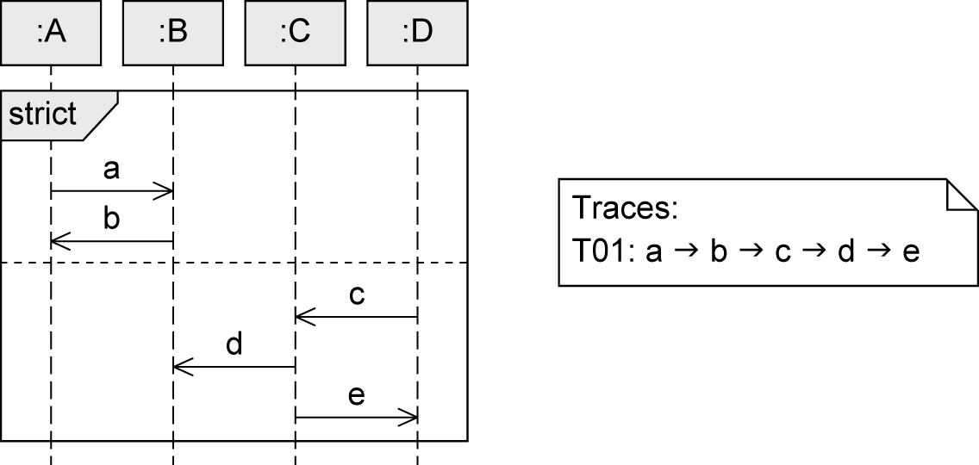
strict Fragment
Sequential interaction with order
Order of event occurrences on different lifelines between different operands is significant
Messages in an operand that is higher up on the vertical axis are always exchanged before the messages in an operand that is lower down on the vertical axis

Slide 22
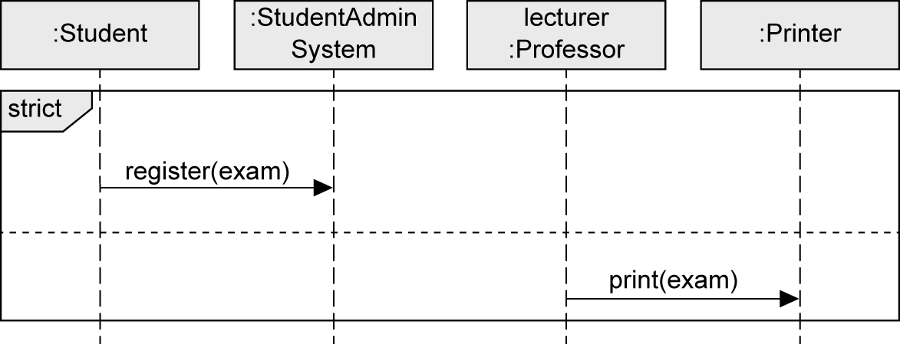
strict Fragment - Example

Slide 23
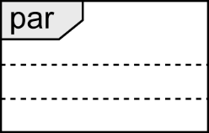
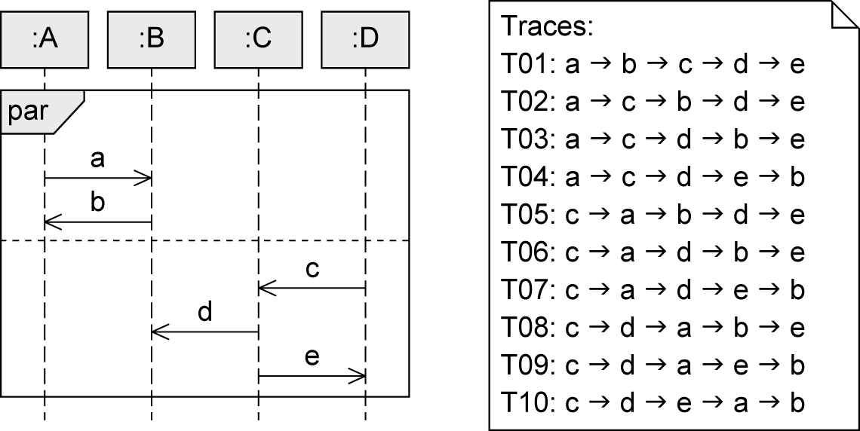
par Fragment
To set aside chronological order between messages in different operands
Execution paths of different operands can be interleaved
Restrictions of each operand need to be respected
Order of the different operands is irrelevant
Concurrency, no true parallelism
Notes:
To set aside: bỏ qua
Irrelevant: ko liên quan
Interleaved: xen kẽ

Slide 24
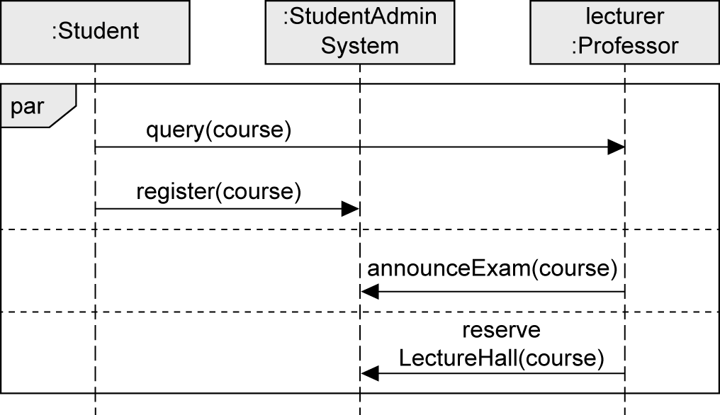
par Fragment - Example

Slide 25
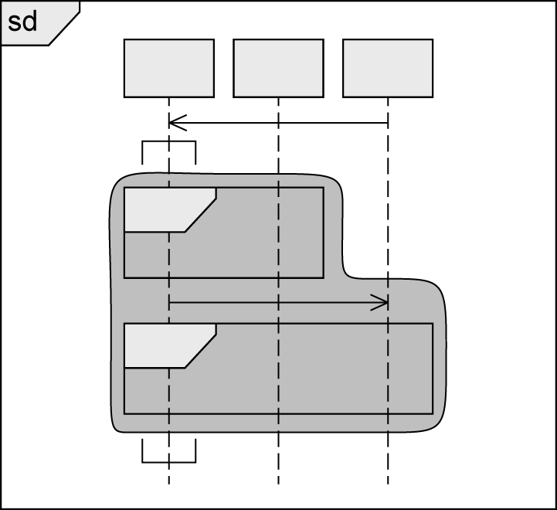
Coregion
To model concurrent events of a single lifeline
Order of event occurrences within a coregion is not restricted
Area of the lifeline to be covered by the coregion is marked by square brackets rotated by 90 degrees
Impact of
coregion
Coregion
Notes:
you can set aside the chronological order of events on a single lifeline using a coregion.
This enables you to model concurrent Coregion rent events for a single lifeline. The order of event occurrences within a coregion is in no way restricted, even though they are arranged along the lifeline.

Slide 26
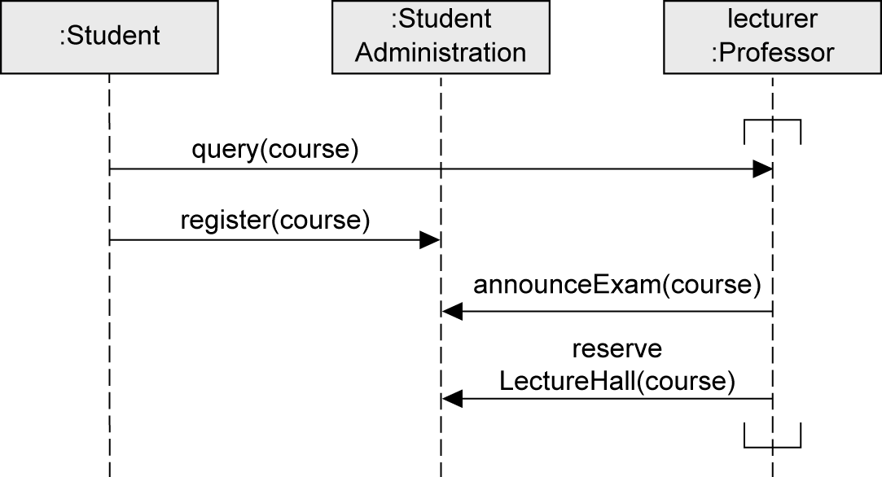
Coregion – Example

Slide 27
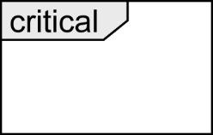
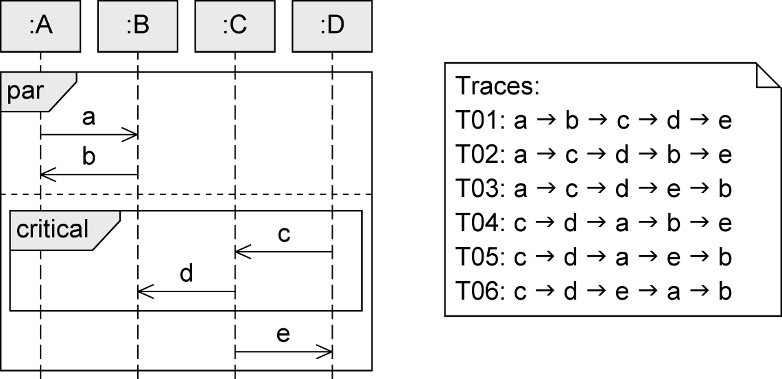
critical Fragment
Atomic area in the interaction (one operand)
To make sure that certain parts of an interaction are not interrupted by unexpected events
Order within critical: default order seq

Slide 28
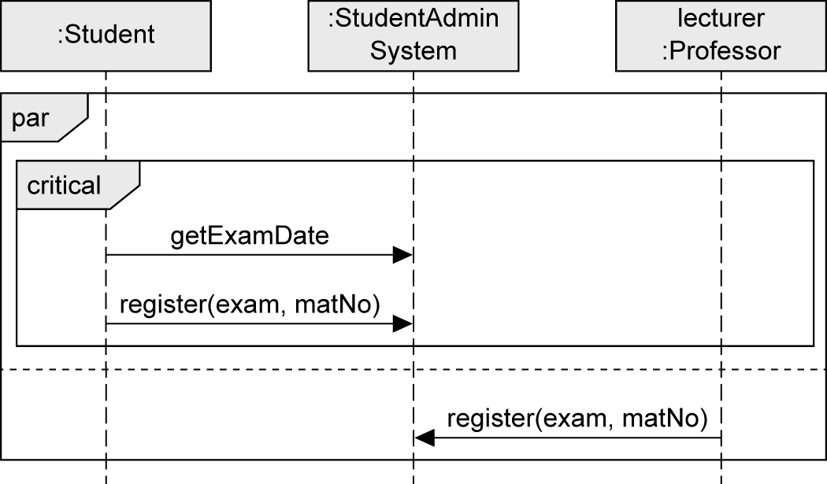
critical Fragment - Example

Slide 29
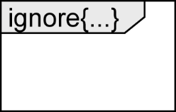
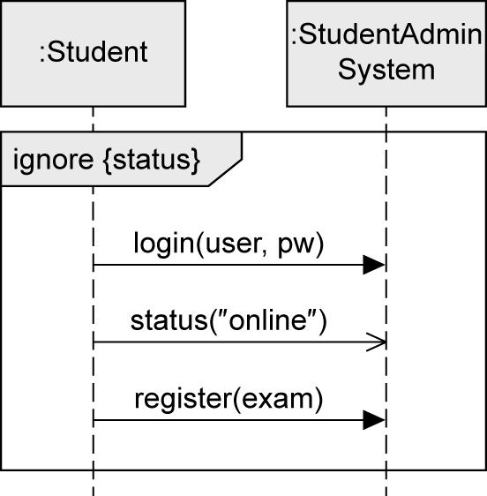
ignore Fragment
To indicate irrelevant messages
Messages may occur at runtime but have no further significance
Exactly one operand
Irrelevant messages in curly brackets after the keyword ignore

Slide 30
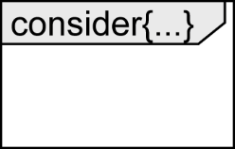
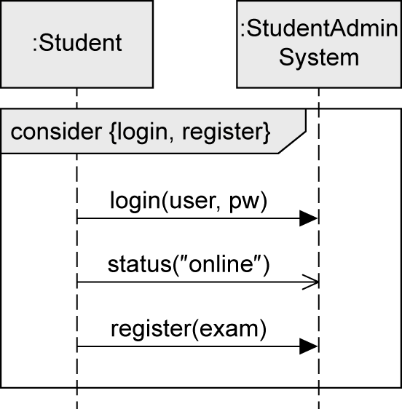
consider Fragment
To specify those messages that are of particular importance for the interaction under consideration
Exactly one operand, dual to ignore fragment
Considered messages in curly brackets after the keyword consider

Slide 31
ignore vs. consider

Slide 32
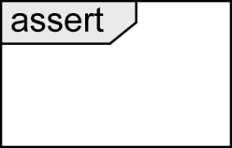
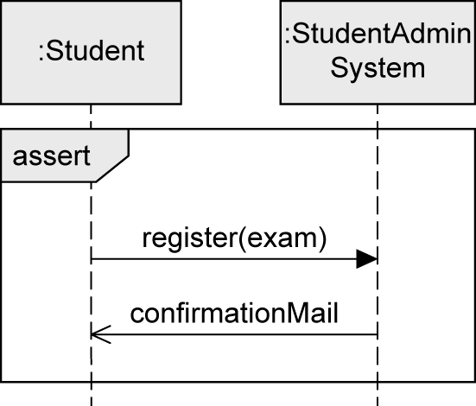
assert Fragment
To identify certain modeled traces as mandatory
Deviations that occur in reality but that are not included in the diagram are not permitted
Exactly one operand
Notes:
Deviations: những sai lệch

Slide 33
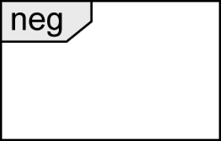
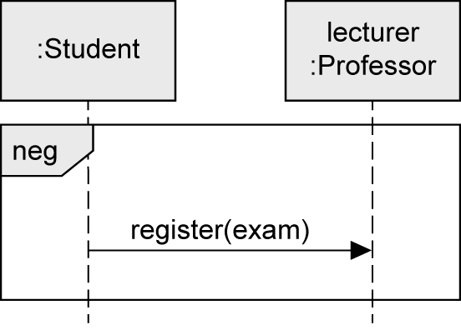
neg Fragment
To model invalid interactions
Describing situations that must not occur
Exactly one operand
Purpose
Explicitly highlighting frequently occurring errors
Depicting relevant, incorrect sequences

Slide 34
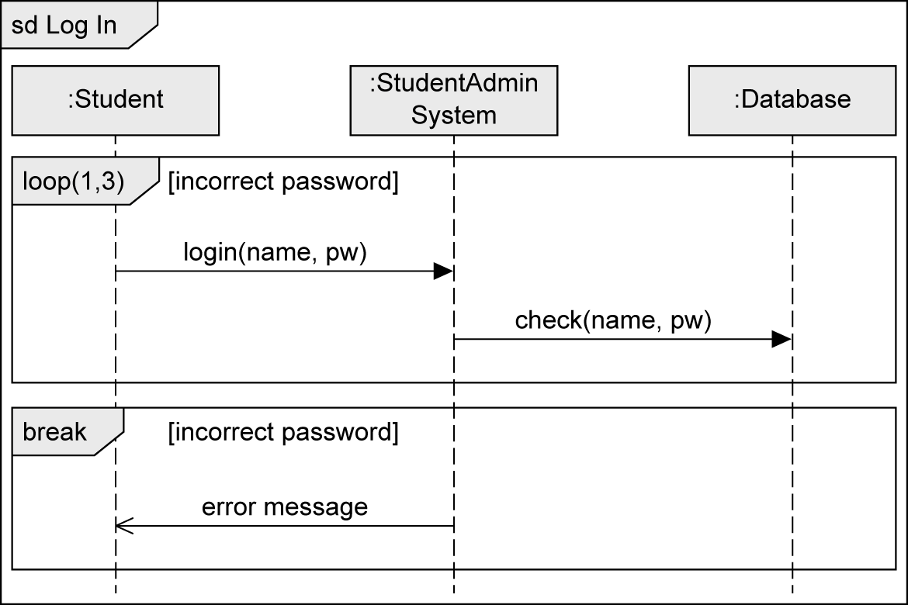
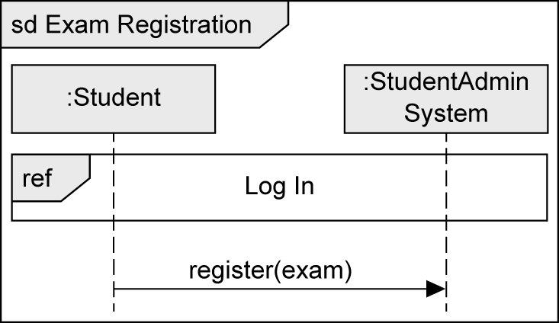
Interaction Reference
Integrates one sequence diagram in another sequence diagram

Slide 35
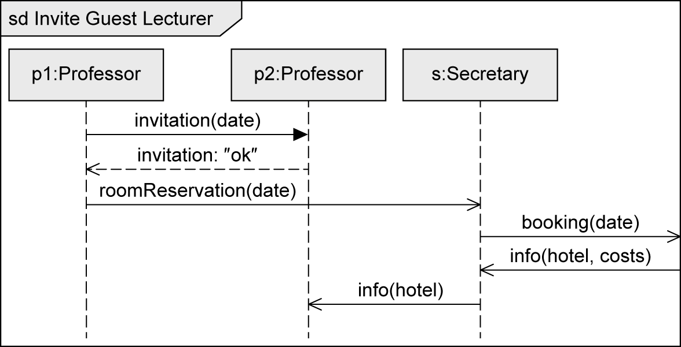

Gate
Allows you to send and receive messages beyond the boundaries of the interaction fragment

Slide 36


Continuation Marker
Modularizes the operands of an alt fragment
Breaks down complex interactions into parts and connect them to one another with markers
Start marker points to target marker
No return to the start marker (in contrast to an interaction reference)
Target
marker
Start
marker

Slide 37


Local Attributes and Parameters
Every sequence diagram is enclosed by a rectangular frame with a small pentagon in the upper left corner
Keyword sd, name of the sequence diagram, parameters (optional)
Example:
void func (int par1, int par2) {
int x = 0;
String y = "Test";
...
}
Option 1:
Parameter
Option 2:
Local
attributes

Slide 38

Time Constraints
Types
Point in time for event occurrence
Relative: e.g., after(5sec)
Absolute: e.g., at(12.00)
Time period between two events
{lower..upper}
E.g., {12.00..13.00}
Predefined actions
now: current time
Can be assigned to an attribute and then used in a time constraint
Duration: calculation of the duration of a message transmission

Slide 39

State Invariant
Asserts that a certain condition must be fulfilled at a certain time
Always assigned to a specific lifeline
Evaluation before the subsequent event occurs
If the state invariant is not true, either the model or the implementation is incorrect
Three alternative notations:

Slide 40

Four Types of Interaction Diagrams (1/4)
Based on the same concepts
Generally equivalent for simple interactions, but different focus
Sequence diagram
Vertical axis:
chronological order
Horizontal axis:
interaction partners

Slide 41

Four Types of Interaction Diagrams (2/4)
Communication diagram
Models the relationships between communication partners
Focus: Who communicates with whom
Time is not a separate dimension
Message order via decimal classification

Slide 42

Four Types of Interaction Diagrams (3/4)
Timing diagram
Shows state changes of the interaction partners that result from the occurrence of events
Vertical axis: interaction partners
Horizontal axis: chronological order

Slide 43

Four Types of Interaction Diagrams (4/4)
Interaction overview diagram
Visualizes order of different interactions
Allows to place various interaction diagrams in a logical order
Basic notation concepts of activity diagram

Slide 44



Notation Elements (1/2)
Name | Notation | Description
Lifeline |  | Interaction partners involved in the communication
Destruction event |  | Time at which an interaction partner ceases to exist
Combined fragment |  | Control constructs

Slide 45




Notation Elements (2/2)
Name | Notation | Description
Synchronous message |  | Sender waits for a response message
Response message |  | Response to a synchronous message
Asynchronous communication |  | Sender continues its own work after sending the asynchronous message
Lost message |  | Message to an unknown receiver
Found message |  | Message from an unknown sender

Slide 46

Câu hỏi ?
Notes:
Nguồn: www.clipartkid.com

